Slide 1
MEMBRANE POTENTIALS
Dr. H. O. Jimoh-Abdulghaffaar

Slide 2
OUTLINE
INTRODUCTION
DEFINITION
TYPES
NORMAL VALUE
IMPORTANCE
RECORDING
APPLIED PHYSIOLOGY

Slide 3
INTRODUCTION
All animal cells are surrounded by a membrane composed of a lipid bilayer with proteins embedded in it. The membrane serves as both an insulator and a diffusion barrier to the movement of ions.
The membrane of almost all cells in the body have electrical potentials.

Slide 4
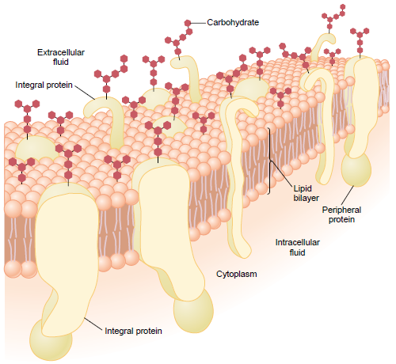
Fig 1: Structure of cell membrane

Slide 5
DEFINITION
The difference in the electrical potential between the interior and exterior of a biological cell.

Slide 6
TYPES
Trans-membrane potential
Dipole potential
Surface potential

Slide 7
Trans-membrane Potential
Most well-known

Slide 8
NORMAL VALUE
-40mV to -90mV

Slide 9
Trans-membrane Potential
In non-excitable cells, and in excitable cells in their baseline states, the membrane potential is held at a relatively stable value, called the resting potential.
In neurons, the factors that influence the membrane potential are diverse. They include numerous types of ion channels, some of which are chemically gated and some of which are voltage-gated.

Slide 10
Trans-membrane Potential

Slide 11
DETERMINANTS
Electrical force
Diffusion

Slide 12
Trans-membrane Potential
Membrane potentials are due to the diffusion of ions down their concentration gradients, the electric charge of the ion, and any membrane pumps for that ion.
Influx is the net movement of ions into the cell from the ECF.
Efflux is the net movement of ions out of the cell to the ECF.
Flux (the movement of charges) is always measured in millivolts (mV).

Slide 13
Diffusion
Caused by differences in ion concentrations between the inside and outside of the cell membrane.
Potassium: higher inside the cell than outside
Sodium: higher outside the cell than outside
Arises from the statistical tendency of particles to redistribute from regions where they are highly concentrated to regions where the concentration is low (due to thermal energy).

Slide 14
Fig 2: Diffusion potential across a nerve cell membrane

Slide 15
Electrical Force
Arises from the mutual attraction between particles with opposite electrical charges (positive and negative) and the mutual repulsion between particles with the same type of charge (both positive or both negative).

Slide 16
Types of trans-membrane potential
Diffusion potential
Resting (membrane) potential
Action potential
Graded potential
Equilibrium (or reverse) potential

Slide 17
Resting (membrane) potential
When the membrane potential of a cell can go for a long period of time without changing significantly, it is referred to as a resting potential or resting voltage. This term is used for the membrane potential of non-excitable cells, but also for the membrane potential of excitable cells in the absence of excitation.
Calculated by the Goldman Equation:

Slide 18
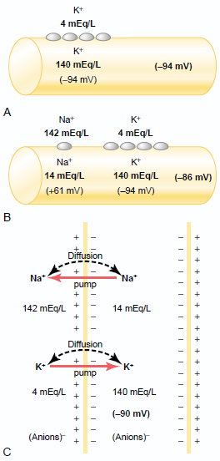
Fig 3: Resting Membrane Potential

Slide 19
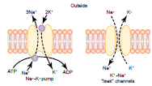
Fig 4: The sodium-potassium ATPase pump

Slide 20
Action Potential
An action potential occurs when there is a reversal of the normal resting potential, going from negative to positive - depolarization.
Depolarization occurs when a stimulus causes the voltage-gated Na⁺ channels to open, allowing Na⁺ to rapidly influx down its concentration gradient.
The sudden in-rush of positive sodium ions reverses the membrane potential for a few milliseconds.
Then the voltage-gated K+ channels open, allowing K⁺ to rapidly efflux due to its concentration gradient. This brings the membrane back to negative inside and is called repolarization.

Slide 21
Resting stage
RMP before action potential begins.
Membrane is said to be polarized at this stage.

Slide 22
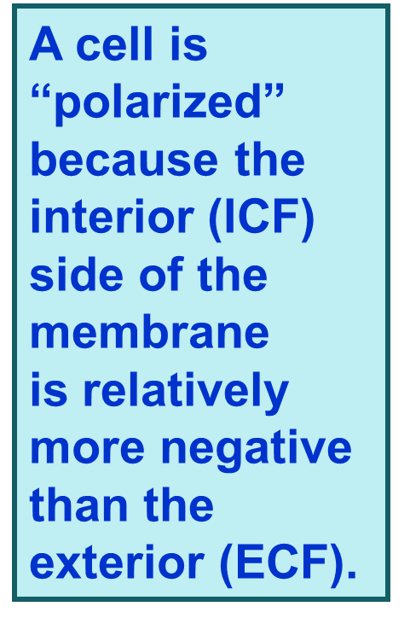
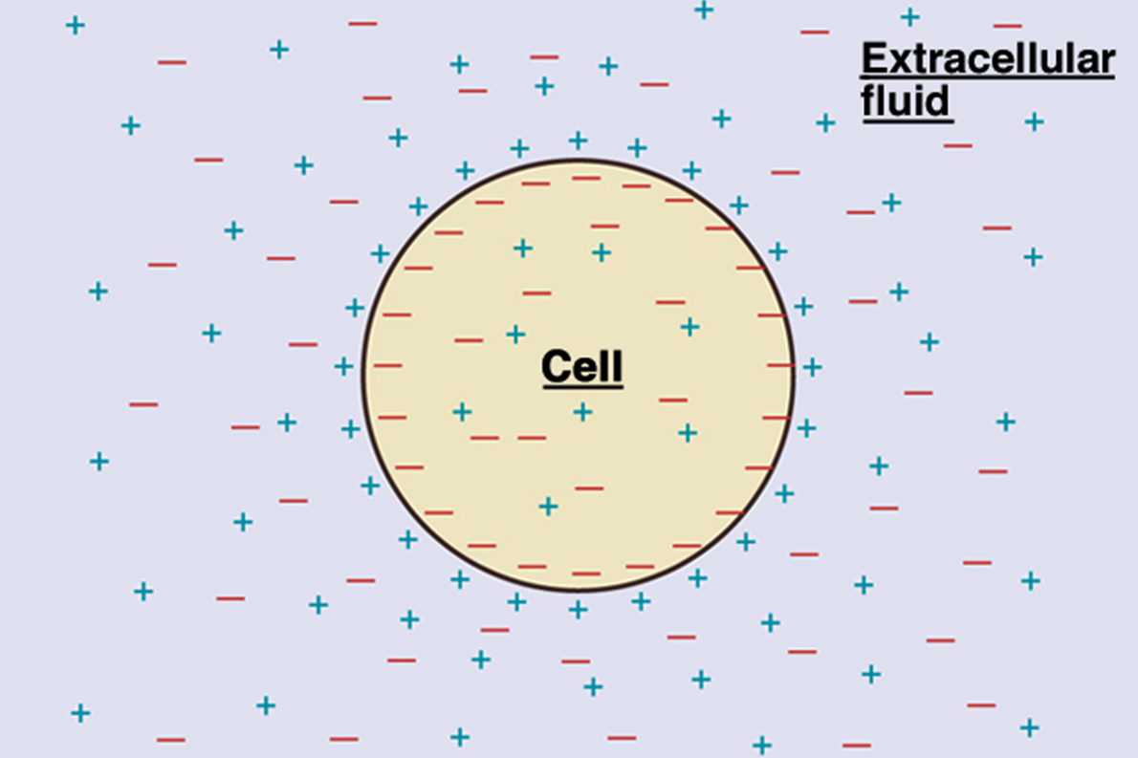
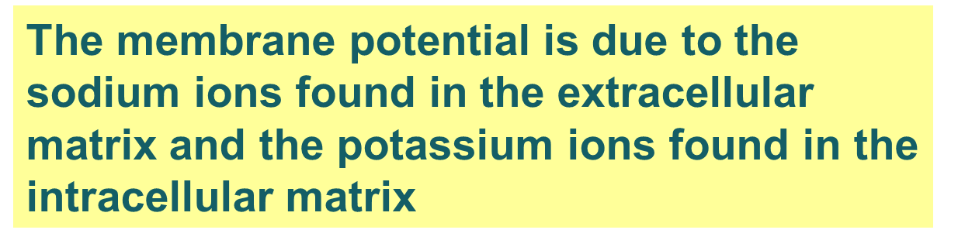
Fig 5: Resting Membrane Potential

Slide 23
Depolarization stage
Membrane suddenly becomes permeable to Na+…..
This rapidly neutralizes the normal “polarized state” of –90mV.
In large nerve fibers, the great excess of Na+ causes the membrane potential to actually overshoot beyond the zero level.
However, this doesn’t occur in smaller fibers.
Activated by the voltage-gated Na+ channel.

Slide 24
Repolarization stage
After being highly permeable to Na+, within milliseconds, the membrane Na+ channels begin to close and the K+ channels open more than normal.
There is rapid diffusion of K+ to the exterior.
This helps to re-establish the normal RMP.
Activated by the voltage-gated K+ channel.

Slide 25
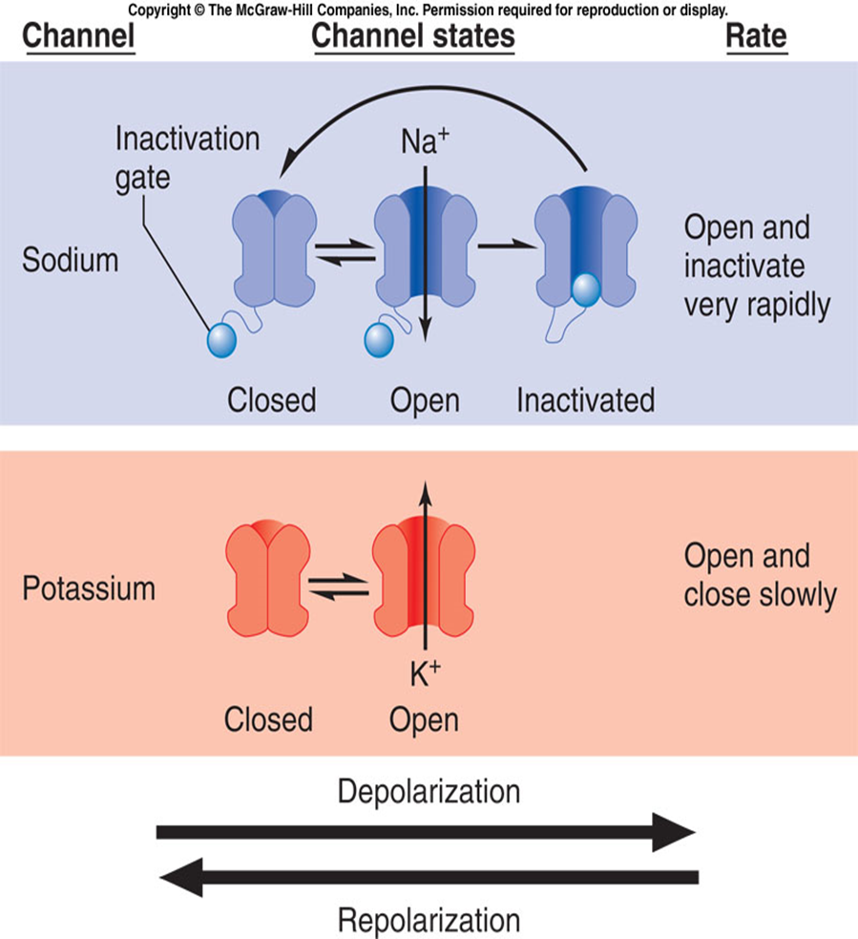
Sodium channels have 2 gates, a normal voltage (activation) gate (which is closed at rest) and an inactivation gate (which is open at rest). The rapid opening of the voltage gate lets Na⁺ rush in and
depolarizes the cell. This is immediately followed by closing of the inactivation gate which stops the Na⁺ influx. At the same time the K⁺ gate opens letting K⁺ efflux (repolarization).
Fig 6: Action Potential

Slide 28
Equilibrium (Reversal) Potential
The reversal potential (or equilibrium potential) of an ion is the value of trans-membrane voltage at which diffusive and electrical forces counterbalance, so that there is no net ion flow across the membrane.
Calculated by Nernst Equation:

Slide 29
IMPORTANCE
Transmission of impulses along nerve and muscle membranes.
Activation of functions of glands, macrophages and ciliated cells.
Production of ATP in the mitochondria.
Activation of the function of some cells e.g. glandular cells, macrophages and ciliated cells.

Slide 30
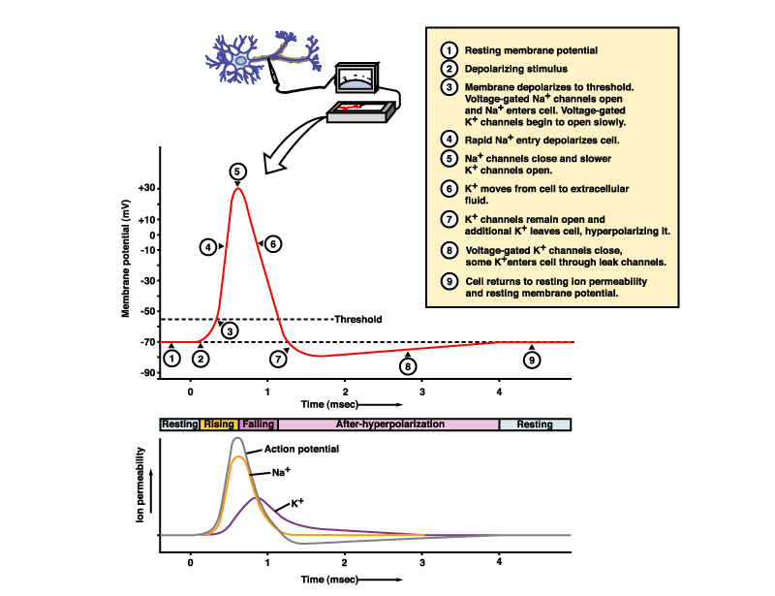
RECORDING
Cathode ray oscilloscope

Slide 31
APPLIED PHYSIOLOGY
Cells may draw on the energy they store in the resting potential to drive action potentials or other forms of excitation. These changes in the membrane potential enable communication with other cells (as with action potentials) or initiate changes inside the cell, which happens in an egg when it is fertilized by a sperm.

